Slide 1
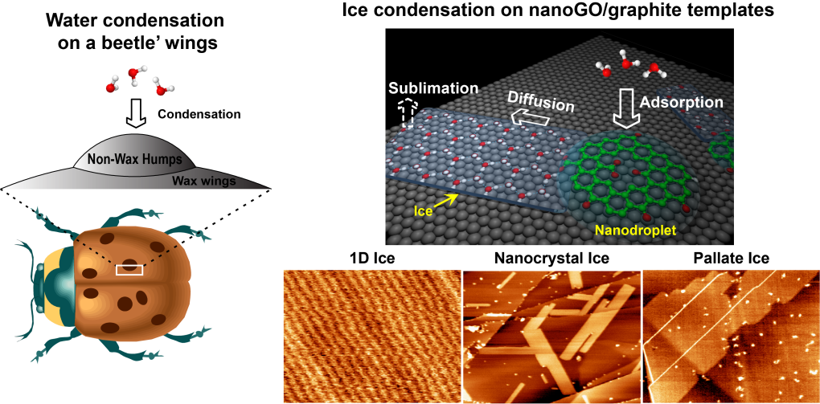
Room-temperature ice growth on graphite seeded by nano graphene oxide
Yi Zheng, Chenliang Su, Jiong Lu, Kian Ping Loh* Angewandte Chemie (Back Cover Page, 2013) DOI: 10.1002/anie.201302608
The Stenocara beetle in the Namib Desert collects drinking droplets from the morning mist using its waxy wings, which are tailored with sub-millimeter hydrophilic humps. Superhydrophilic graphene oxide nanoflakes are biomimetic analogues of these humps and can seed ice nucleation on hydrophobic graphite. Various ice solids can thus be grown at ambient conditions (see images).

Slide 2
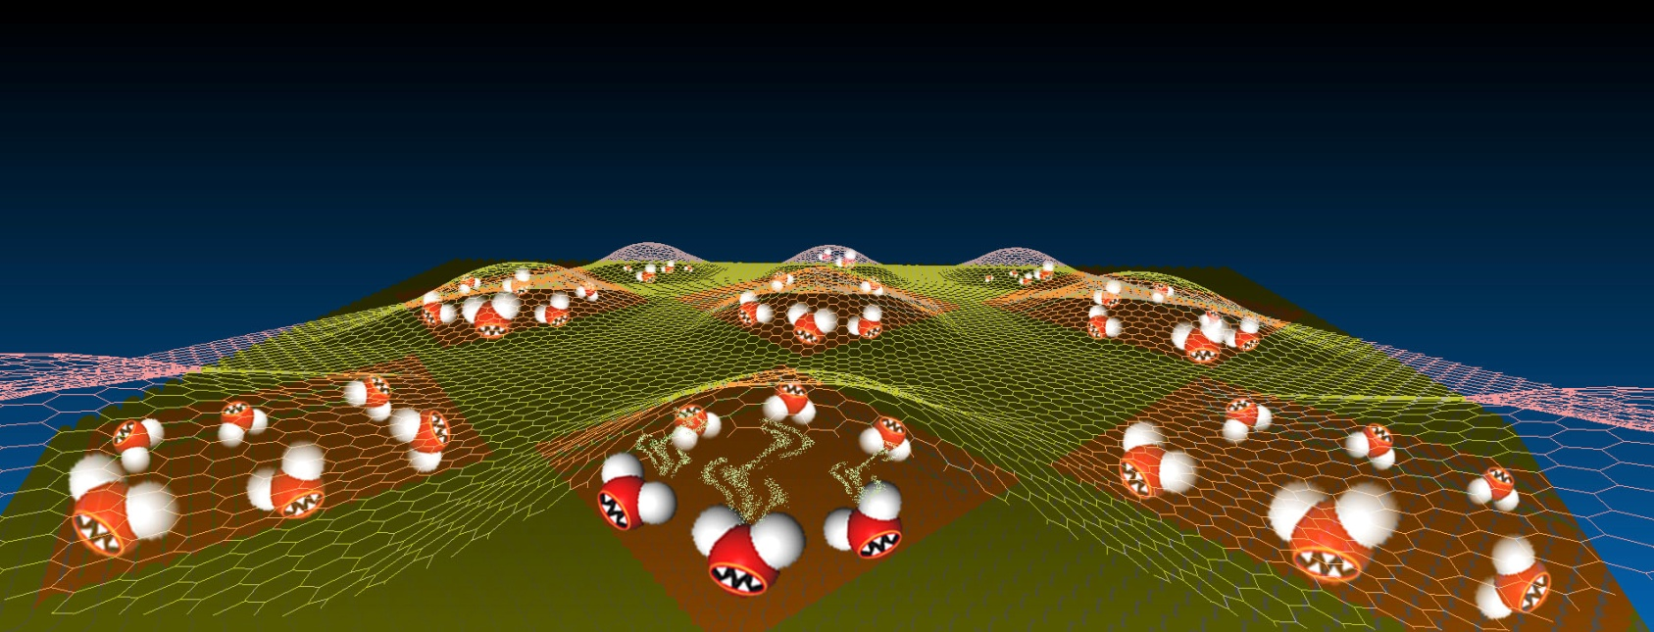
A Hydrothermal Anvil made of Graphene Nanobubbles
on Diamond
Candy Su, Kian Ping Loh et. al.* Nature Communications 4 (2013) 1556
The molecular structure of superheated water trapped in the bubble was probed
using vibrational spectroscopy and dynamic changes in the hydrogen
bonding environment was observed. The graphene-diamond hydrothermal anvil can serve as a useful bench-top construct for investigating the dynamic chemistry of supercritical phases in fluids.

Slide 3
Graphene Oxide and Copper-centered Metal Organic Framework
Composite as a Tri-Functional Catalyst for HER, OER and ORR
DOI: 10.1002/adfm.201300510
A composite of graphene oxide and copper-centered metal organic framework shows good performance as a tri-functional catalyst for hydrogen evolution reaction (HER), oxygen evolution reaction (OER) and oxygen reduction reaction (ORR). One of the challenges in the area of electrocatalysis is to find an effective catalyst that will reduce as well as generate oxygen at moderate temperatures. Here, we describe the synthesis of a composite made from graphene oxide (GO) and Cu (II)-centered MOF which shows enhanced electrocatalytic properties and stability in acid due to the presence of GO. In PEM fuel cell testing, the GO-incorporated, Cu-MOF composite delivers power density that is 76% that of the commercial Pt catalyst.

